Slide 1
Database Management System
Modules:
  Database System Concepts & Architecture
  Data Modeling-Relational and ER modeling
  DB Design-Schema Refinement
  Physical DB Design & Query Processing
  Transaction Processing
  Concurrency control & Recovery Techniques
  NOSQL DB management
  Recent Trends

Slide 2
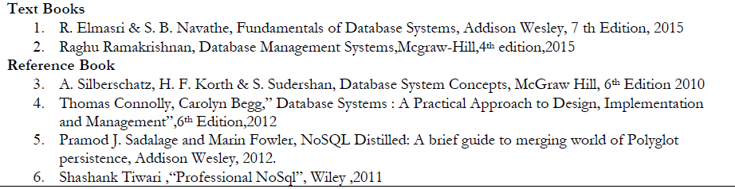
Database Management System

Slide 3
Module-1
Database system concepts and Architecture

Slide 4
Module-1: Database system concepts and Architecture
Need for database systems
Characteristics of Database Approach
Advantages of using DBMS approach
Actors on the Database Management Scene
Database Administrator
Classification of database management systems
Data Models
Schemas and Instances
Three-Schema Architecture
The Database System Environment
Centralized and Client/Server Architectures for DBMSs
Overall Architecture of Database Management Systems

Slide 5
Database System Applications
DBMS contains information about a particular enterprise
  Collection of interrelated data
  Set of programs to access the data
  An environment that is both convenient and efficient to use
Database Applications:
  Banking: all transactions
  Airlines: reservations, schedules
  Universities: registration, grades
  Sales: customers, products, purchases
  Online retailers: order tracking, customized recommendations
  Manufacturing: production, inventory, orders, supply chain
  Human resources: employee records, salaries, tax deductions
Databases touch all aspects of our lives

Slide 6
What Is a DBMS?
A very large, integrated collection of data.
Models real-world enterprise.
  Entities (e.g., students, courses)
  Relationships (e.g., Madonna is taking CS564)
A Database Management System (DBMS) is a software package designed to store and manage databases.

Slide 7
Why Use a DBMS?
Data independence and efficient access.
Reduced application development time.
Data integrity and security.
Uniform data administration.
Concurrent access, recovery from crashes.
Notes:
3

Slide 8
Files vs. DBMS
Application must stage large datasets between main memory and secondary storage (e.g., buffering, page-oriented access, 32-bit addressing, etc.)
Special code for different queries
Must protect data from inconsistency due to multiple concurrent users
Crash recovery
Security and access control

Slide 9
Purpose of Database Systems
In the early days, database applications were built directly on top of file systems
Drawbacks of using file systems to store data:
  Data redundancy and inconsistency
    Multiple file formats, duplication of information in different files
  Difficulty in accessing data
    Need to write a new program to carry out each new task
  Data isolation — multiple files and formats
  Integrity problems
    Integrity constraints (e.g. account balance > 0) become “buried” in program code rather than being stated explicitly
    Hard to add new constraints or change existing ones

Slide 10
Purpose of Database Systems (Cont.)
Drawbacks of using file systems (cont.)
  Atomicity of updates
    Failures may leave database in an inconsistent state with partial updates carried out
    Example: Transfer of funds from one account to another should either complete or not happen at all
  Concurrent access by multiple users
    Concurrent accessed needed for performance
    Uncontrolled concurrent accesses can lead to inconsistencies
      Example: Two people reading a balance and updating it at the same time
  Security problems
    Hard to provide user access to some, but not all, data
Database systems offer solutions to all the above problems

Slide 11
Summary
DBMS used to maintain, query large datasets.
Benefits include recovery from system crashes, concurrent access, quick application development, data integrity and security.
Levels of abstraction give data independence.
A DBMS typically has a layered architecture.
DBAs hold responsible jobs and are well-paid! ☺
DBMS R&D is one of the broadest, most exciting areas in CS.

Slide 12

View of Data/Data Abstraction

Slide 13

External Level
Logical Level
DATA
Physical Level

Slide 14


Which song, which album mmmmm ?

Slide 15



Physical Level

Slide 16

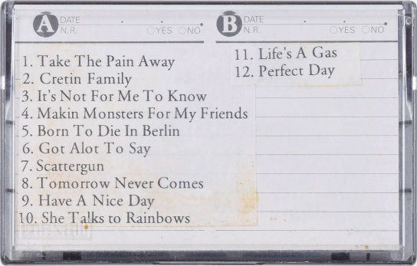
Logical Level

Slide 17
External Level
Can listen only one song at an instance… but not all songs together

Slide 18
Three-Schema Architecture
Defines DBMS schemas at three levels:
  Internal schema at the internal level to describe physical storage structures and access paths (e.g indexes).
    Typically uses a physical data model.
  Conceptual schema at the conceptual level to describe the structure and constraints for the whole database for a community of users.
    Uses a conceptual or an implementation data model.
  External schemas at the external level to describe the various user views.
    Usually uses the same data model as the conceptual schema.

Slide 19
Physical Level:
  Describes HOW data are actually stored
  It deals with the data structures used in physical
  It is otherwise called as Internal level
Logical Level:
  Describes WHAT data is stored in database and their relationships among data
  This level is usually designed by using ER diagrams
  It is otherwise called as Conceptual Level, Schema level
External Level:
  Only part of the database can be viewed at a time but not the entire database
  Database has many views
  It is otherwise called as Subschema level, View level

Slide 20
Levels of Abstraction
Physical level: describes how a record (e.g., customer) is stored.
Logical level: describes data stored in database, and the relationships among the data.
  type customer = record
  customer_id : string;
  customer_name : string;
  customer_street : string;
  customer_city : string;
        end;
View level: application programs hide details of data types. Views can also hide information (such as an employee’s salary) for security purposes.

Slide 21
Data Independence
Changing data or structure in one level without effecting higher levels
Applications insulated from how data is structured and stored.
Logical data independence: Protection from changes in logical structure of data.
Physical data independence: Protection from changes in physical structure of data.
One of the most important benefits of using a DBMS!

Slide 22
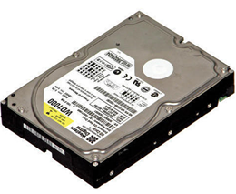
Physical Data Independence
External Level
Logical Level
Physical Level

Slide 23
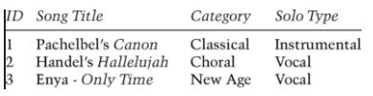
Logical Data Independence
External Level
Logical Level
Physical Level

Slide 24
Data Models
A collection of tools for describing
  Data
  Data relationships
  Data semantics
  Data constraints
Relational model
Entity-Relationship data model (mainly for database design)
Object-based data models (Object-oriented and Object-relational)
Semi structured data model (XML)
Other older models:
  Network model
  Hierarchical model

Slide 25
Reg.No
First Name of Student
Last Name of Student
Middle Name of Student

Slide 26
Both network and hierarchical models are involved with more number of pointers.
A single misplaced pointer corrupts the entire database.
Relational Model is free from pointers

Slide 27
Data Models
The relational model of data is the most widely used model today.
  Main concept: relation, basically a table with rows and columns.
  Every relation has a schema, which describes the columns, or fields.

Slide 28
Relational Model
Table name
Attribute names
Product
PName | Price | Category | Manufacturer
Gizmo | $19.99 | Gadgets | GizmoWorks
Powergizmo | $29.99 | Gadgets | GizmoWorks
SingleTouch | $149.99 | Photography | Canon
MultiTouch | $203.99 | Household | Hitachi
Tuples or rows

Slide 29
A tuple/ row is a combination of different column values of one real world object.
Number of columns represents degree of the table
Number of tuples represents cardinatily of the table
Tuple is identified uniquely by using primary key
Note: The term “Relation” is abstract and “Table” is concrete

Slide 30
Instances and Schemas
Similar to types and variables in programming languages
Schema – the logical structure of the database
  Example: The database consists of information about a set of customers and accounts and the relationship between them)
  Analogous to type information of a variable in a program
  Physical schema: database design at the physical level
  Logical schema: database design at the logical level
Instance – the actual content of the database at a particular point in time

Slide 31

Example of a Database Schema

Slide 32

Example of a database state

Slide 33
Example: University Database
Conceptual schema:
  Students(sid: string, name: string, login: string,
  age: integer, gpa:real)
  Courses(cid: string, cname:string, credits:integer)
  Enrolled(sid:string, cid:string, grade:string)
Physical schema:
  Relations stored as unordered files.
  Index on first column of Students.
External Schema (View):
  Course_info(cid:string,enrollment:integer)
Notes:
7

Slide 34
DATA BASE LANGUAGE
Data Manipulation Language (DML)
Language for accessing and manipulating the data organized by the appropriate data model
  DML also known as query language
Two classes of languages
  Procedural – user specifies what data is required and how to get those data
  Declarative (nonprocedural) – user specifies what data is required without specifying how to get those data
SQL is the most widely used query language

Slide 35
Data Definition Language (DDL)
Specification notation for defining the database schema
  Example: create table account (
  account_number char(10),
  branch_name char(10),
  balance integer)
DDL compiler generates a set of tables stored in a data dictionary
Data dictionary contains metadata (i.e., data about data)
  Database schema
  Data storage and definition language
    Specifies the storage structure and access methods used
  Integrity constraints
    Domain constraints
    Referential integrity (e.g. branch_name must correspond to a valid branch in the branch table)
  Authorization

Slide 36
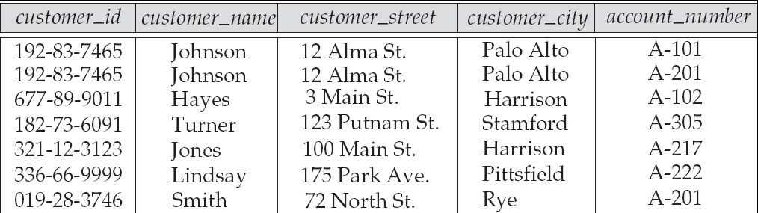
Relational Model
Example of tabular data in the relational model
Attributes

Slide 37

A Sample Relational Database
Slide No:L3-4

Slide 38
SQL
SQL: widely used non-procedural language
  Example: Find the name of the customer with customer-id 192-83-7465
  select customer.customer_name
  from customer
  where customer.customer_id = ‘192-83-7465’
  Example: Find the balances of all accounts held by the customer with customer-id 192-83-7465
  select account.balance
  from depositor, account
  where depositor.customer_id = ‘192-83-7465’ and
  depositor.account_number = account.account_number
Slide No:L3-5

Slide 39
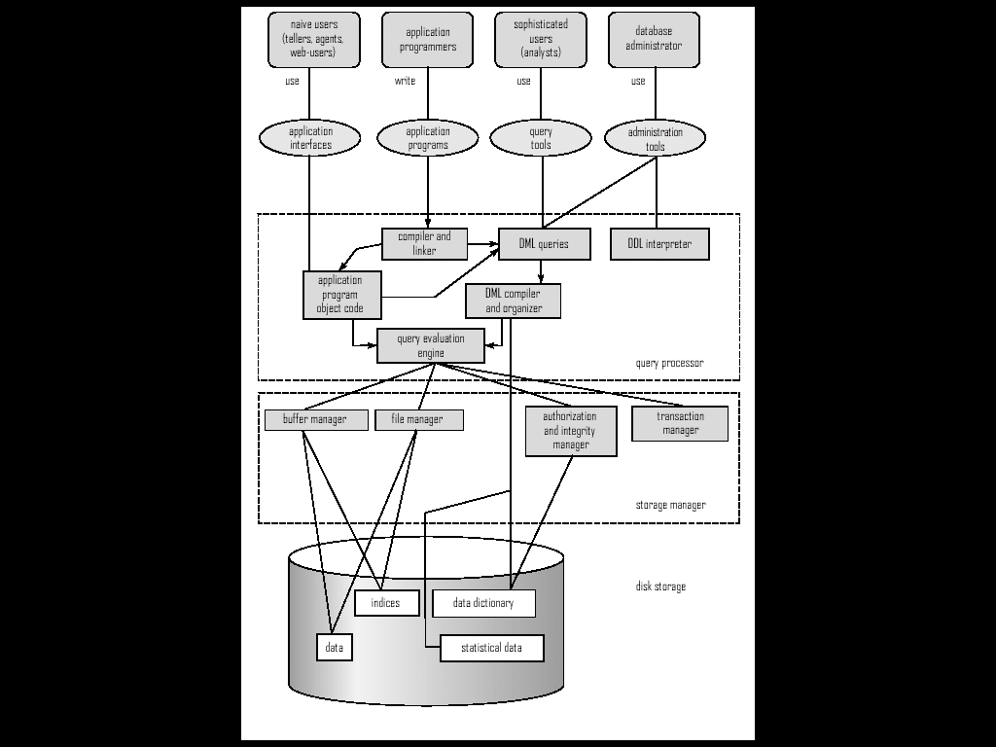
Data Base System Structure
Slide No:L6-2

Slide 40
Database Users /Actors on the Scene
Users are differentiated by the way they expect to interact with
the system
Application programmers – interact with system through DML calls
Sophisticated users – form requests in a database query language
Specialized users – write specialized database applications that do not fit into the traditional data processing framework
Naïve users – invoke one of the permanent application programs that have been written previously
  Examples, people accessing database over the web, bank tellers, clerical staff
Slide No:L4-1

Slide 41
Database Administrator
Coordinates all the activities of the database system
  has a good understanding of the enterprise’s information resources and needs.
Database administrator's duties include:
  Storage structure and access method definition
  Schema and physical organization modification
  Granting users authority to access the database
  Backing up data
  Monitoring performance and responding to changes
  Database tuning
Slide No:L4-2

Slide 42
Tools Used
Data dictionary / repository:
  Used to store schema descriptions and other information such as design decisions, application program descriptions, user information, usage standards, etc.
  Active data dictionary is accessed by DBMS software and users/DBA.
  Passive data dictionary is accessed by users/DBA only.
Slide 2- <number>

Slide 43
Data storage and Querying
Storage management
Query processing
Transaction processing
Slide No:L5-1

Slide 44
Storage Management
Storage manager is a program module that provides the interface between the low-level data stored in the database and the application programs and queries submitted to the system.
The storage manager is responsible to the following tasks:
  Interaction with the file manager
  Efficient storing, retrieving and updating of data
Issues:
  Storage access
  File organization
  Indexing and hashing
Slide No:L5-2

Slide 45

Query Processing
1.Parsing and translation
2. Optimization
3. Evaluation
Slide No:L5-3

Slide 46
Query Processing (Cont.)
Alternative ways of evaluating a given query
  Equivalent expressions
  Different algorithms for each operation
Cost difference between a good and a bad way of evaluating a query can be enormous
Need to estimate the cost of operations
  Depends critically on statistical information about relations which the database must maintain
  Need to estimate statistics for intermediate results to compute cost of complex expressions
Slide No:L5-4

Slide 47
Transaction Management
A transaction is a collection of operations that performs a single logical function in a database application
Transaction-management component ensures that the database remains in a consistent (correct) state despite system failures (e.g., power failures and operating system crashes) and transaction failures.
Concurrency-control manager controls the interaction among the concurrent transactions, to ensure the consistency of the database.
Slide No:L5-5

Slide 48
Database Architecture
The architecture of a database systems is greatly influenced by
the underlying computer system on which the database is running:
Centralized
Client-server
Parallel (multiple processors and disks)
Distributed
Slide No:L6-1

Slide 49
Centralized and
Client-Server DBMS Architectures
Centralized DBMS
  Combines everything into single system including- DBMS software, hardware, application programs, and user interface processing software.
  User can still connect through a remote terminal – however, all processing is done at centralized site.
Slide 2- <number>

Slide 50

A Physical Centralized Architecture
Slide 2- <number>

Slide 51
Basic 2-tier Client-Server Architectures
Specialized Servers with Specialized functions
  Print server
  File server
  DBMS server
  Web server
  Email server
Clients can access the specialized servers as needed
Ex. Games and Music Players
Fast to access
Slide 2- <number>

Slide 52

Logical two-tier client server architecture
Slide 2- <number>

Slide 53
Clients
Provide appropriate interfaces through a client software module to access and utilize the various server resources.
Clients may be diskless machines or PCs or Workstations with disks with only the client software installed.
Connected to the servers via some form of a network.
  (LAN: local area network, wireless network, etc.)
Slide 2- <number>

Slide 54
DBMS Server
Provides database query and transaction services to the clients
Relational DBMS servers are often called SQL servers, query servers, or transaction servers
Applications running on clients utilize an Application Program Interface (API) to access server databases via standard interface such as:
  ODBC: Open Database Connectivity standard
  JDBC: for Java programming access
Client and server must install appropriate client module and server module software for ODBC or JDBC
Slide 2- <number>

Slide 55
Two Tier Client-Server Architecture
A client program may connect to several DBMSs, sometimes called the data sources.
In general, data sources can be files or other non-DBMS software that manages data.
Other variations of clients are possible: e.g., in some object DBMSs, more functionality is transferred to clients including data dictionary functions, optimization and recovery across multiple servers, etc.
Slide 2- <number>

Slide 56
Three Tier Client-Server Architecture
Common for Web applications
Intermediate Layer called Application Server or Web Server:
  Stores the web connectivity software and the business logic part of the application used to access the corresponding data from the database server
  Acts like a conduit for sending partially processed data between the database server and the client.
Three-tier Architecture Can Enhance Security:
  Database server only accessible via middle tier
  Clients cannot directly access database server
Slide 2- <number>

Slide 57

Three-tier client-server architecture
Slide 2- <number>

Slide 58
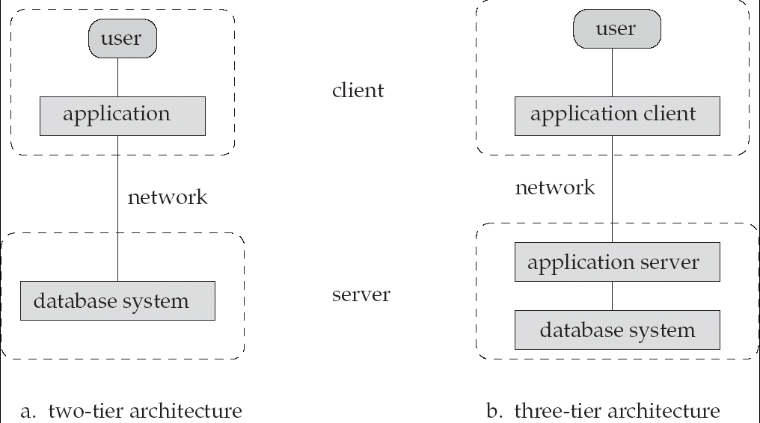
Database Application Architectures
(web browser)
Old
Modern

Slide 59
Classification of DBMSs
Based on the data model used
  Traditional: Relational, Network, Hierarchical.
  Emerging: Object-oriented, Object-relational.
Other classifications
  Single-user (typically used with personal computers)
  vs. multi-user (most DBMSs).
  Centralized (uses a single computer with one database)
  vs. distributed (uses multiple computers, multiple databases)
Slide 2- <number>

Slide 60
Variations of Distributed DBMSs (DDBMSs)
Homogeneous DDBMS
Heterogeneous DDBMS
Federated or Multidatabase Systems
Distributed Database Systems have now come to be known as client-server based database systems because:
  They do not support a totally distributed environment, but rather a set of database servers supporting a set of clients.
Slide 2- <number>

Slide 61
Cost considerations for DBMSs
Cost Range: from free open-source systems to configurations costing millions of dollars
Examples of free relational DBMSs: MySQL, PostgreSQL, others
Commercial DBMS offer additional specialized modules, e.g. time-series module, spatial data module, document module, XML module
  These offer additional specialized functionality when purchased separately
  Sometimes called cartridges (e.g., in Oracle) or blades
Different licensing options: site license, maximum number of concurrent users (seat license), single user, etc.
Slide 2- <number>

Slide 62
Classification of Database Systems
centralized database system: the DBMS and database are stored at a single site that is used by several other systems too
distributed database system: the actual database and the DBMS software are distributed from various sites that are connected by a computer network
heterogeneous distributed database system: different sites might use different DBMS software, but there is additional common software to support data exchange between these sites
homogeneous distributed database systems: use the same DBMS software at multiple sites

Slide 63
Classification of Database Systems
multiuser database system: a database management system which supports multiple users concurrently
object-oriented data model: a database management system in which information is represented in the form of objects as used in object-oriented programming
single-user database system: a database management system which supports one user at a time
traditional models: data models that preceded the relational model

